Slide 1

CMSC 635 Presentation #3
Janusz Slawek

Slide 2
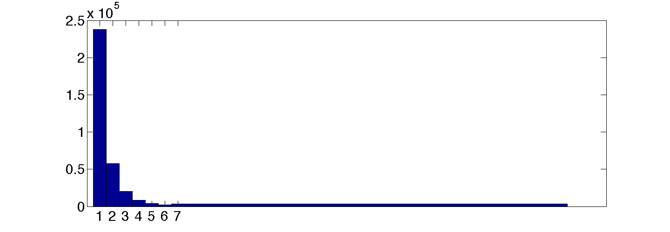
Determining Classes
Number of distinct patient_ids: 509630
Number of distinct patient_nbrs: 333797
Patient_ids of patients histogram:

Slide 3
Determining Classes
333797 distinct patients (patient_nbr).
161695 of them have both successful and unsuccessful encounters:
Successful: discharge_disposition_id == 1,
Unsuccessful: discharge_disposition_id != 1.
If all the encounters were successful than class==0, if all the encounters were unsuccessful class==1.

Slide 4
Determining Classes
If a patient has both successful and unsuccessful encounters:
if the last 3 encounters were successful than class==0, but consider the medications only for the successful ones,
otherwise class=1.
{1,1,1,1,1,1,1,1,1,1,1,19}: class=1
{19,3,5,6,3,7,5,23,1,1,1}: class==0

Slide 5
Determining Features
9400912 times a patient is assigned a medication in medication_facts_diabetes.
There’re 19158 distinct medication brand names in medication_dim table, but only 3907 of them were assigned to patients:
i^{th} row in feature table corresponds to one patient,
j^{th} column in feature table corresponds to one medication,
F_{i,j} is number of times the i^{th} patient was assigned j^{th} medication.

Slide 6
Determining Features
Patient_nbr | Coumadin | Synthroid | … | Selsun Blue 2 in 1
9 | 5 | 1 | … | 0
135 | 0 | 0 | … | 0
252 | 2 | 0 | … | 0
378 | 0 | 0 | … | 0
729 | 0 | 0 | … | 0
774 | 0 | 0 | … | 0
… |  |  | …
189510332 | 0 | o | … | 0
189512537 | 0 | 0 | … | 0
189515462 | 0 | 0 | … | 0
189517028 | 0 | 0 | … | 0

Slide 7
Determining Features
Feature table size: 333793 x 3907. It’s too much for WEKA or MATLAB:
subsampled features table: 52946 x 3052.
Visualizing the data set using PCA, MDS.
Selecting features based on ROC-rank.
Running SVM classifier and testing the performance on subsampled data set. Testing the performance against the number of features and SVM classifier parameter c, and different types of kernels.

Slide 8
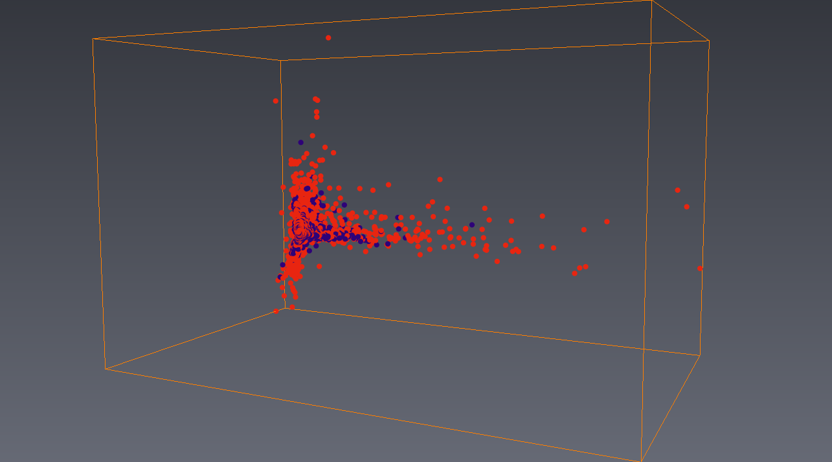
Visualization
PCA
first 3 components ~33% of overall variance:

Slide 9

Thank you for your attention!
Questions?

